Slide 1
Introduction to JetHexa

Slide 2
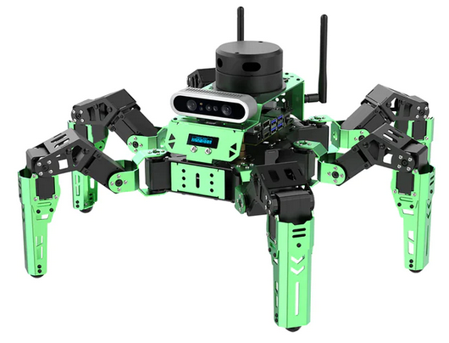
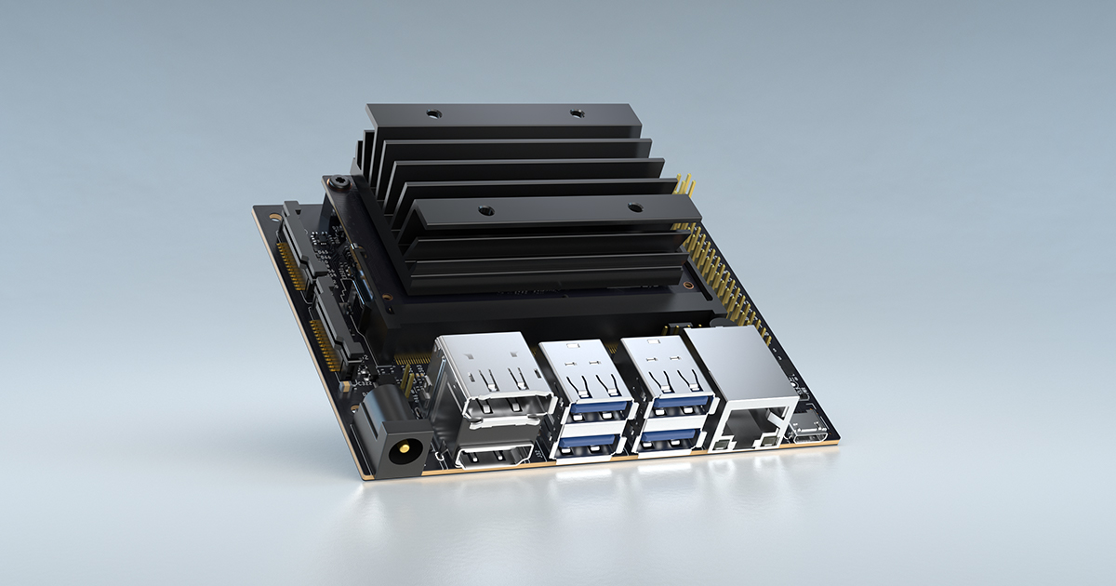

What is the JetHexa
The JetHexa is a hexapod or spider robot
The JetHexa is controlled by an Nvidia Jetson Nano
Features a depth sensing camera, LiDAR sensor for mapping, and 18 servos to control the limbs of the robot
The JetHexa is capable of running and training Machine Learning models

Slide 3
What can the JetHexa Do?
Robotic Control
Through coding on the device, or through the app, the JetHexa can perform simple actions; moving forward or backward, twisting, stretching, and etc.
These actions don’t involve Machine Learning, they are just commands for the servos of specific positions to take and in what order
LiDAR Control
A LiDAR sensor sends out beams of light, which hit surfaces and reflect back to the sensor. The sensor is then able to detect the distance to the sensor based on how long it took for the light to return
Combing this with actions, the JetHexa is able to do Obstacle Avoidance, Centering Around an Object, and Object Following with the LiDAR
Also capable of mapping out its environment with SLAM

Slide 4
What can the JetHexa Do?
Machine Learning
The Jetson Nano is capable of running and training a Machine Learning model on the device due to the on board GPU
Face Tracking, Object Tracking, Line Following, Smile or No Smile and various other Machine Learning models; whatever you can think of
Machine Learning with Actions
The Machine Learning models can be combined with the input from the camera along with defined actions
If the model detects something, like a face, an action can be taken

Slide 5
Connecting to the JetHexa
Two primary ways of connecting to and controlling the JetHexa
The HiWonder phone App
Remote Connection with VNC and a Laptop

Slide 6
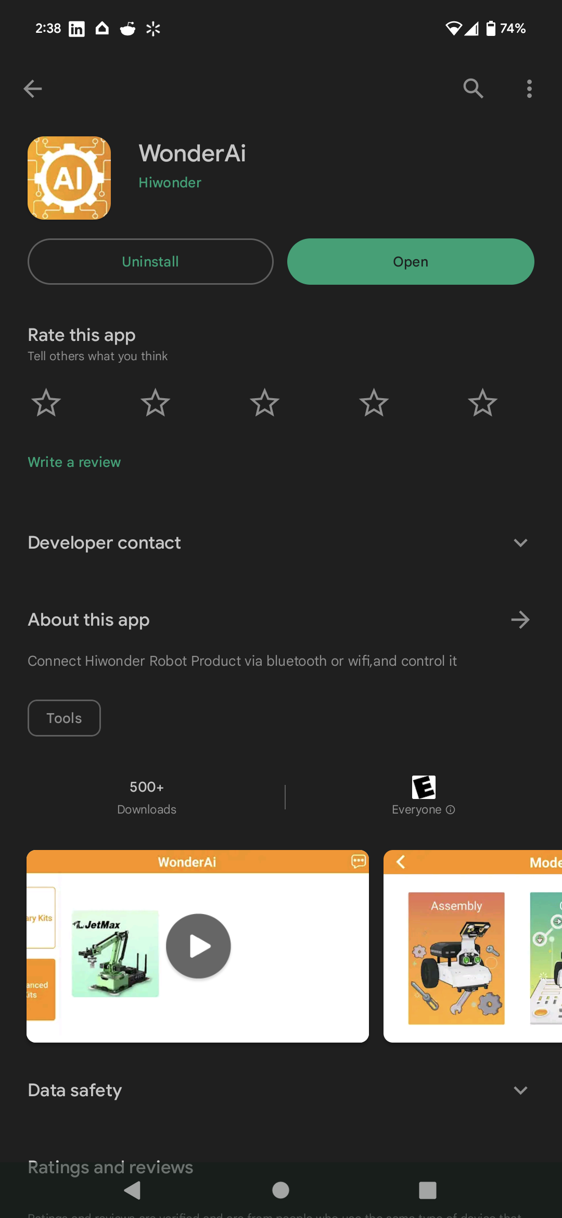
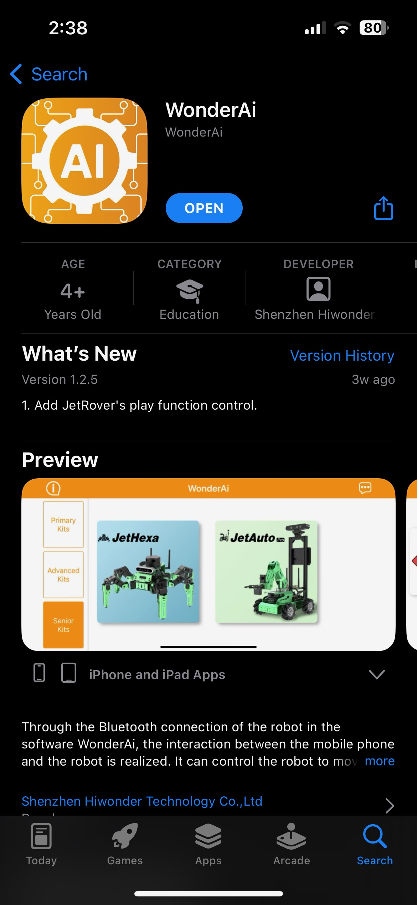
Connecting to the JetHexa with a Phone
On your phone, download the WonderAI app from your app store
Search “HiWonder” and select the “WonderAI” app

Slide 7
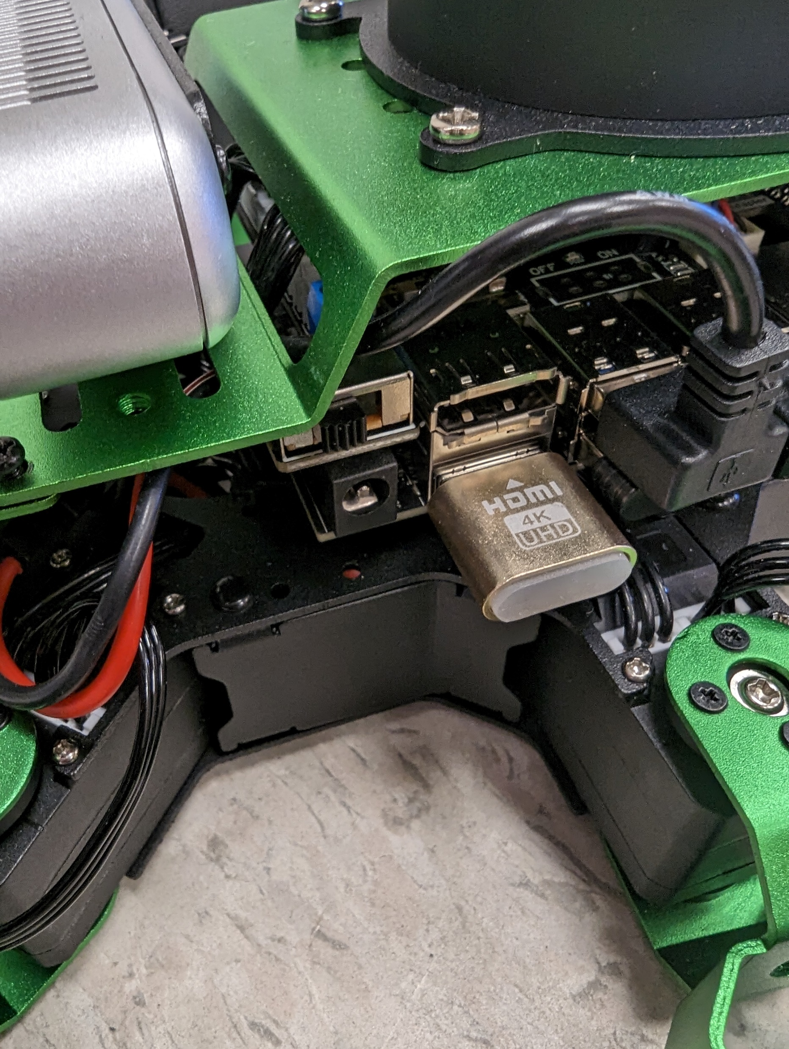
Connecting to the JetHexa with a Phone
Turn On the JetHexa
There is a switch on the right hand side, when looking from the front, of the JetHexa

Slide 8
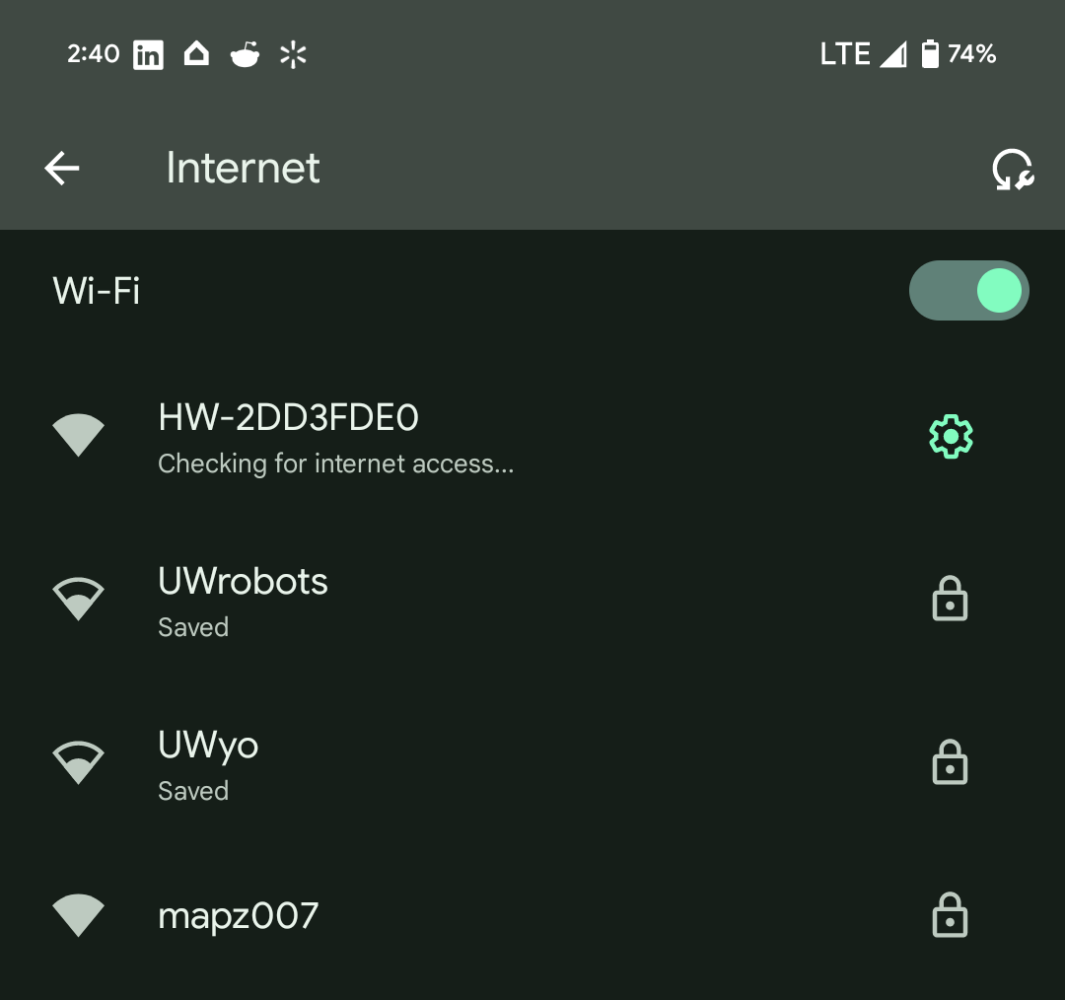
Connecting to the JetHexa with a Phone
Go to your WiFi settings of your phone and look for a WiFi starting with “HW-”
If asked for a password, enter “hiwonder”

Slide 9
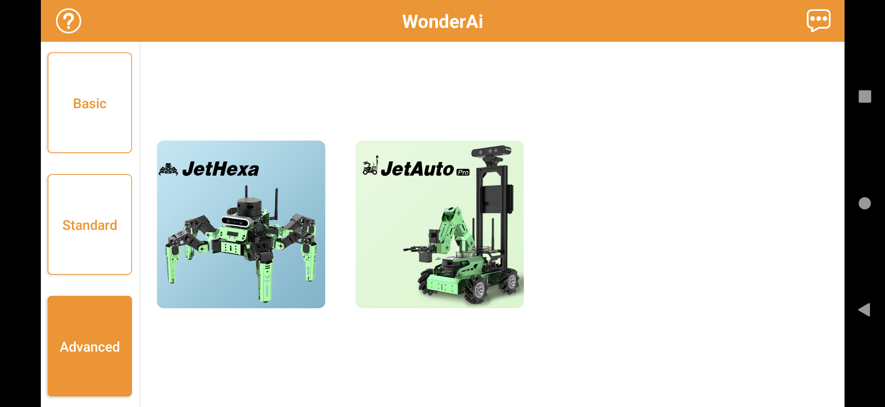
Connecting to the JetHexa with a Phone
Now open the WonderAI app

Slide 10
Connecting to the JetHexa with a Phone
Select the “Advanced” option and then select “JetHexa”

Slide 11
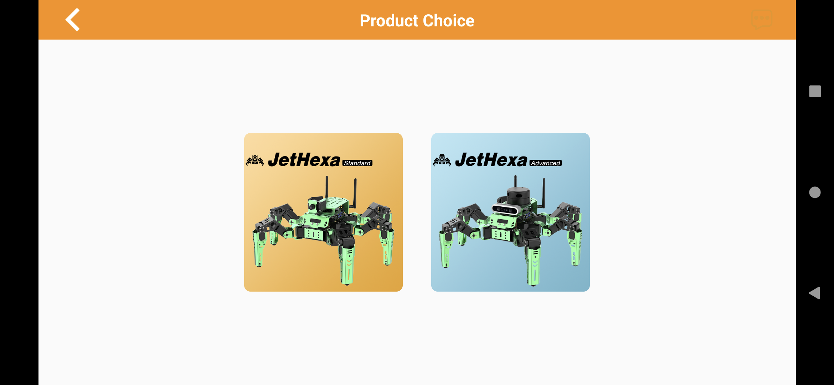
Connecting to the JetHexa with a Phone
For the Product Choice, select the “JetHexa Advanced”

Slide 12
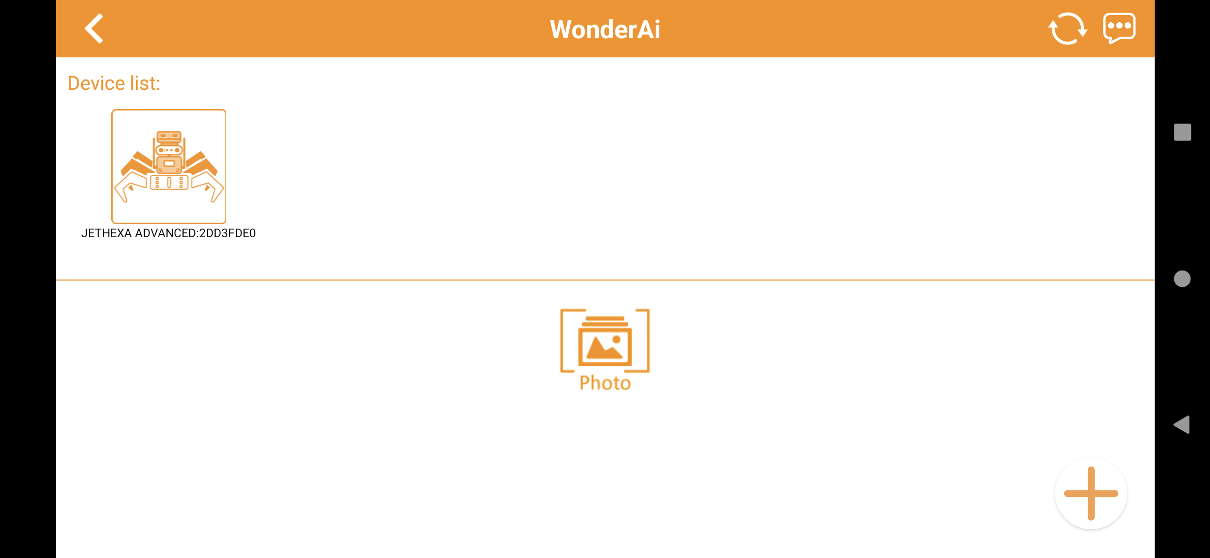
Connecting to the JetHexa with a Phone
Select the JetHexa Device your are connected to

Slide 13
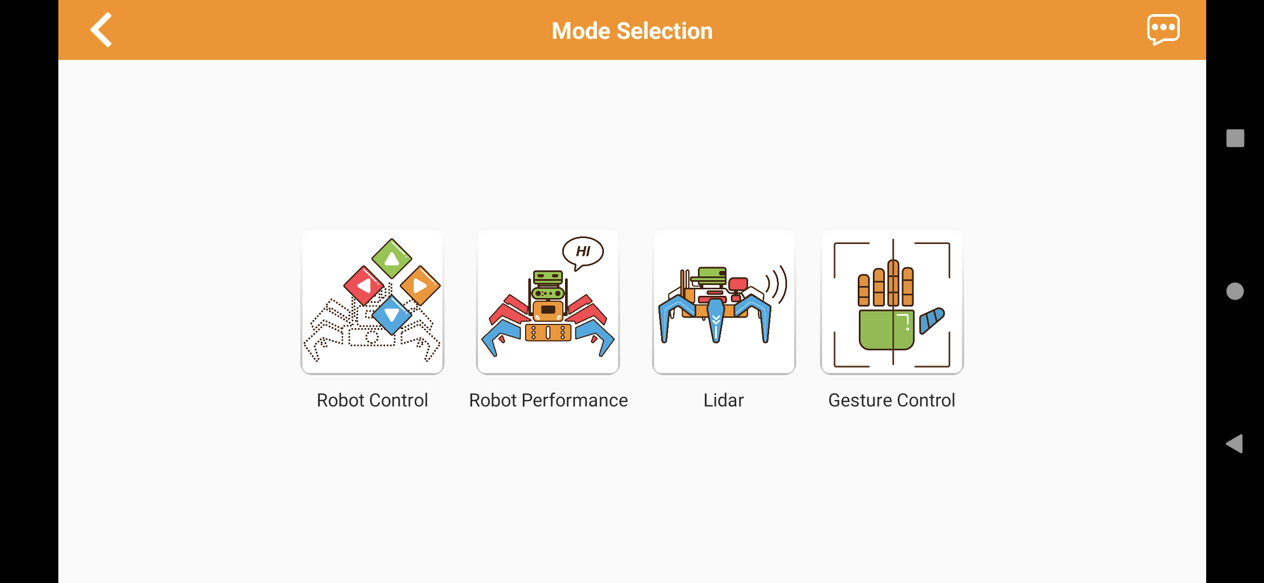
Connecting to the JetHexa with a Phone
Select the “Robot Control” in Mode Selection

Slide 14
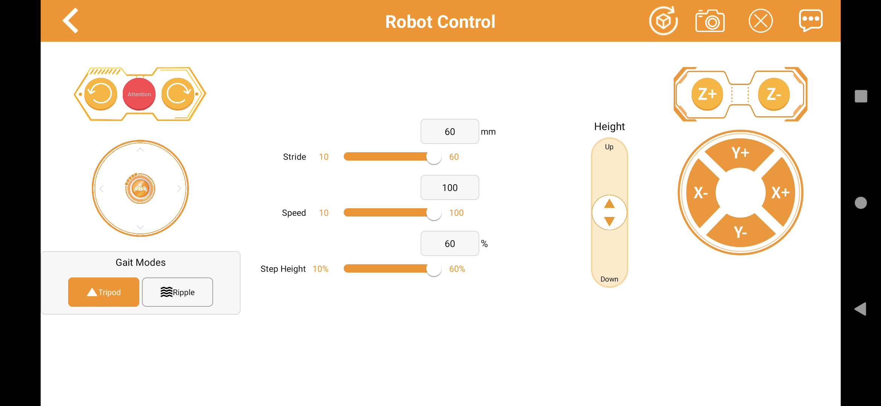
Connecting to the JetHexa with a Phone
Play around and move the robot around

Slide 15
Connecting to the JetHexa with a Phone
Go back to Mode Selection with the arrow in the top left corner and then select “Robot Performance”

Slide 16
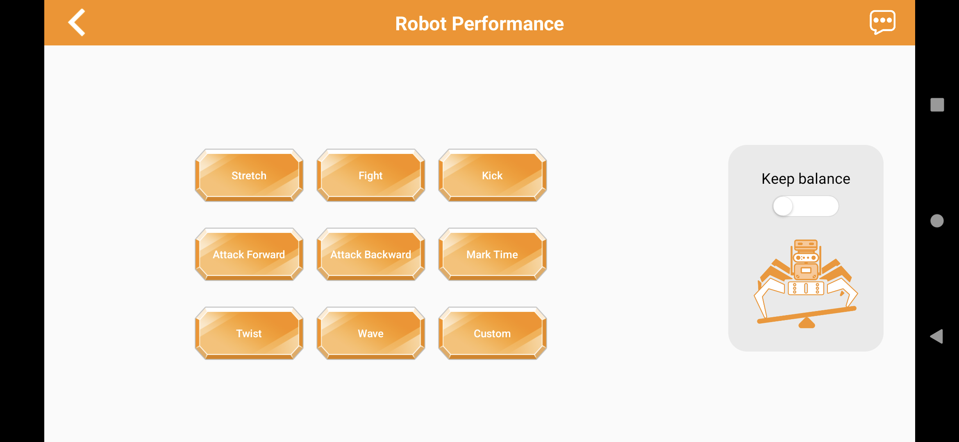
Connecting to the JetHexa with a Phone
Click on all of the different actions

Slide 17
Connecting to the JetHexa with a Phone
Once Complete, close the “WonderAI” app and disconnect from the WiFi

Slide 18
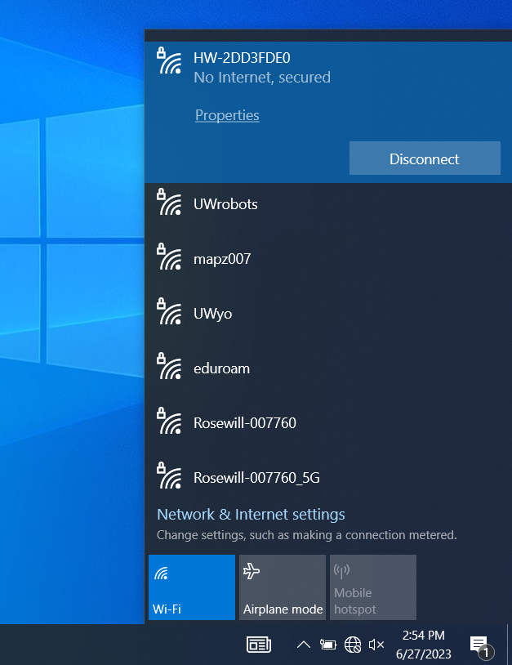
Connecting to the JetHexa with a Laptop
Open the Laptop and connect to the JetHexa WiFi on the laptop
If asked for a password, type “hiwonder”

Slide 19
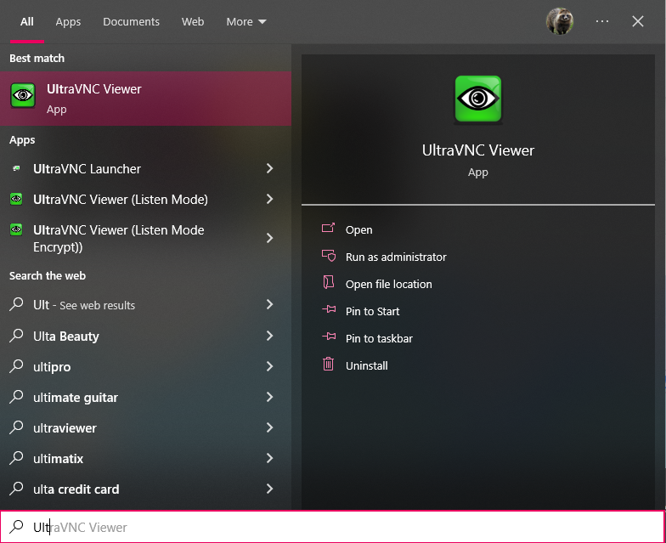
Connecting to the JetHexa with a Laptop
In the search bar, type “UltraVNC” and then run the program

Slide 20
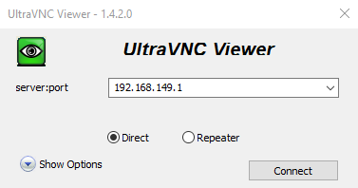
Connecting to the JetHexa with a Laptop
Enter the IP address of the JetHexa into UltraVNC, found on the LCD screen on the JetHexa, then click “Connect”

Slide 21
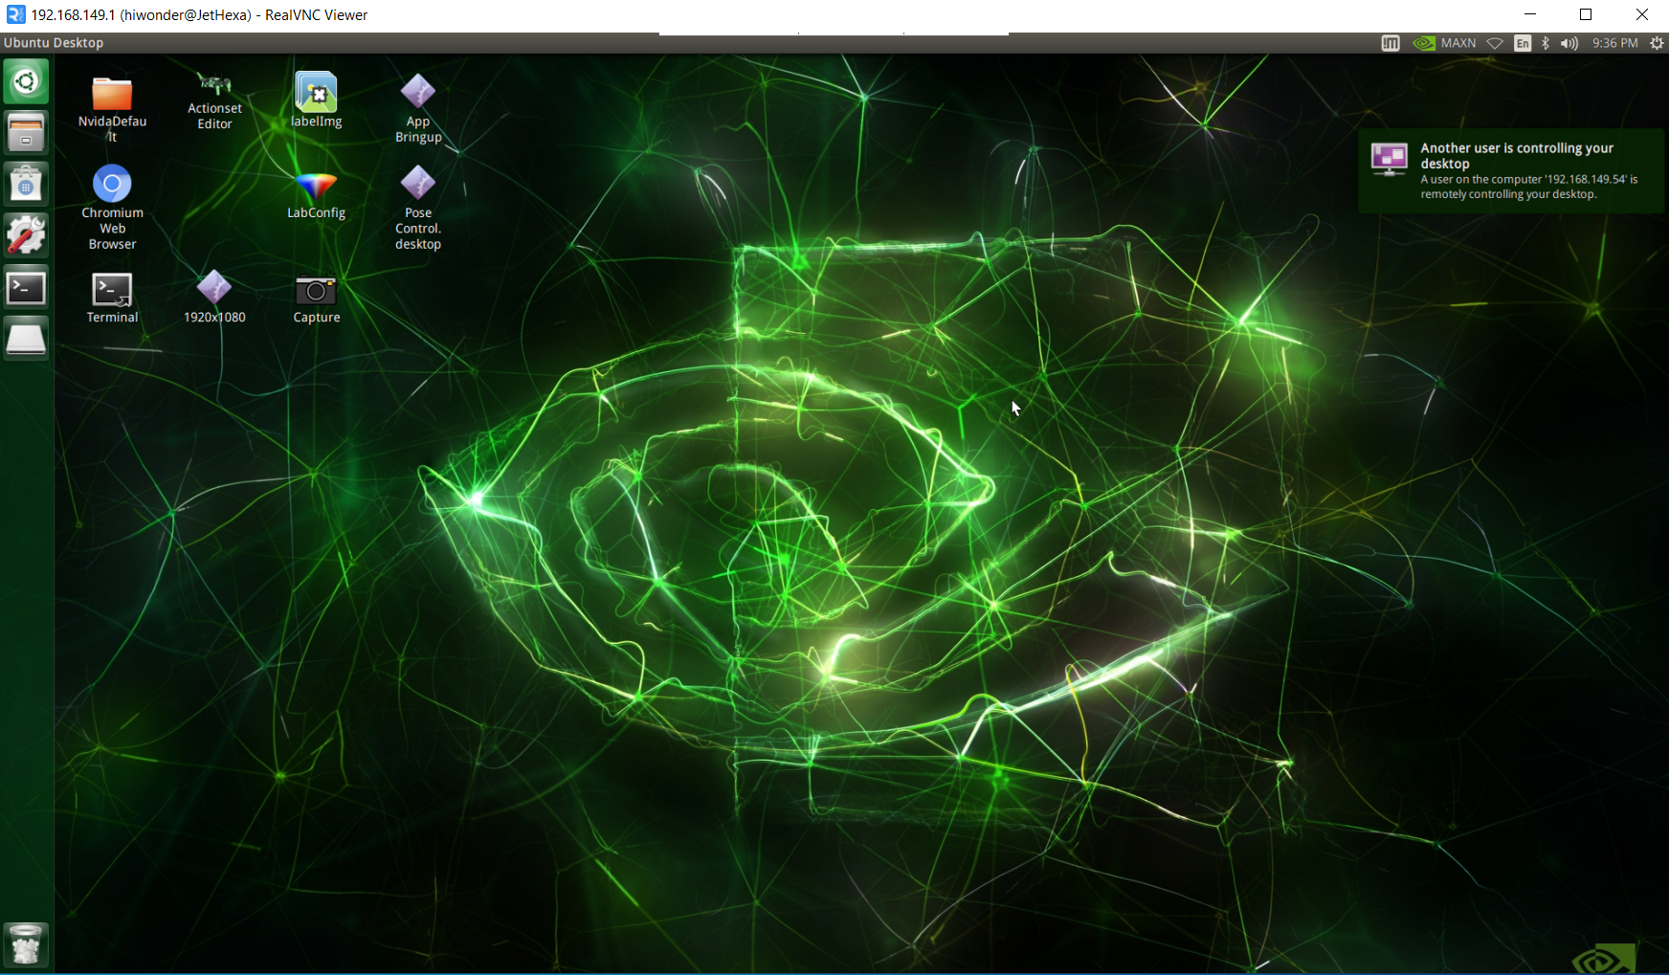
Connecting to the JetHexa with a Laptop
You should now be connected to the JetHexa and should see a similar screen as below
Note that UltraVNC is slow and it might take a second to see your actions reflected on the screen

Slide 22
Up Next
Simple Actions on the JetHexa

